Slide 1
Uncertainty

Slide 2
Knowledge Representation
KR Language | Ontological Commitment | Epistemological Commitment
Propositional Logic | facts | true, false, unknown
First Order Logic | facts, objects, relations | true, false, unknown
Temporal Logic | facts, objects, relations, times | true, false, unknown
Probability Theory | facts | degree of belief
Fuzzy Logic | facts, degree of truth | known interval values
Probabilistic Relational Models
- combine probability and first order logic

Slide 3
Need for Reasoning w/ Uncertainty
The world is full of uncertainty
chance nodes/sensor noise/actuator error/partial info..
Logic is brittle
can’t encode exceptions to rules
can‘t encode statistical properties in a domain
Computers need to be able to handle uncertainty
Probability: new foundation for AI (& CS!)
Massive amounts of data around today
Statistics and CS are both about data
Statistics lets us summarize and understand it
Statistics is the basis for most learning
Statistics lets data do our work for us
•3

Slide 4
Logic vs. Probability
Symbol: Q, R … | Random variable: Q …
Boolean values: T, F | Domain: you specify e.g. {heads, tails} [1, 6]
State of the world: Assignment to Q, R … Z | Atomic event: complete specification of world: Q… Z Mutually exclusive Exhaustive
 | Prior probability (aka Unconditional prob: P(Q)
 | Joint distribution: Prob. of every atomic event •4

Slide 5
Probability Basics
Begin with a set S: the sample space
e.g., 6 possible rolls of a die.
x ϵ S is a sample point/possible world/atomic event
A probability space or probability model is a sample space with an assignment P(x) for every x s.t.
0≤P(x)≤1 and ∑P(x) = 1
An event A is any subset of S
e.g. A= ‘die roll < 4’
A random variable is a function from sample points to some range, e.g., the reals or Booleans

Slide 6
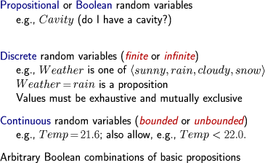
Types of Probability Spaces
•6

Slide 7
Axioms of Probability Theory
All probabilities between 0 and 1
– 0 ≤ P(A) ≤ 1
P(true) = 1
P(false) = 0.
The probability of disjunction is:
P( A ∨ B) = P( A) + P(B) − P( A ∧ B)
A ∧ B
A
B
True
•© UW CSE AI Faculty
•7

Slide 8
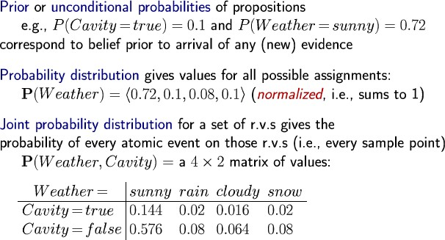
Prior Probability
Joint distribution can answer any question
•8

Slide 9
Conditional probability
Conditional or posterior probabilities
e.g., P(cavity | toothache) = 0.8
i.e., given that toothache is all I know there is 80% chance of cavity
Notation for conditional distributions:
P(Cavity | Toothache) = 2-element vector of 2-element vectors)
If we know more, e.g., cavity is also given, then we have
P(cavity | toothache, cavity) = 1
New evidence may be irrelevant, allowing simplification:
P(cavity | toothache, sunny) = P(cavity | toothache) = 0.8
This kind of inference, sanctioned by domain knowledge, is crucial
•9

Slide 10
Conditional Probability
P(A | B) is the probability of A given B
Assumes that B is the only info known.
Defined by:
P( A ∧ B)
P( A | B) =
P(B)
True
A
A∧B
B
•© UW CSE AI Faculty
10

Slide 11
Chain Rule/Product Rule
P(X₁, …, X_{n}) = P(X_{n}|X₁..X_{n-1})P(X_{n-1}|X₁..X_{n-2})… P(X₁)
= ПP(X_{i}|X₁,..X_{i-1})

Slide 12
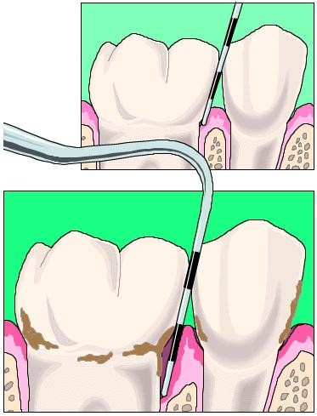

Dilemma at the Dentist’s
What is the probability of a cavity given a toothache?
What is the probability of a cavity given the probe catches?
12

Slide 13
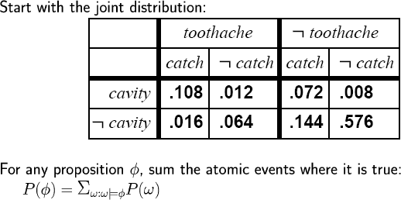
Inference by Enumeration
P(toothache)=.108+.012+.016+.064
= .20 or 20%

Slide 14
Inference by Enumeration
P(toothache∨cavity) = .20 + .072 + .008
.28
??

Slide 15
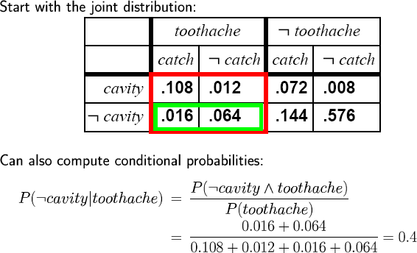
Inference by Enumeration

Slide 16
Complexity of Enumeration
Worst case time: O(d^{n})
Where d = max arity
And n = number of random variables
Space complexity also O(d^{n})
Size of joint distribution
Prohibitive!

Slide 17
Independence
A and B are independent iff:
P(A | B) = P(A)
P(B | A) = P(B)
These two constraints are logically equivalent
Therefore, if A and B are independent:
P( A | B) = ^{P( A ∧ B)} = P( A)
P(B)
P( A ∧ B) = P( A)P(B)

Slide 18
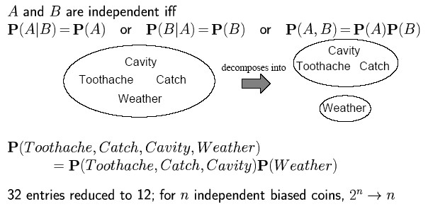
Independence
31
10;
Complete independence is powerful but rare What to do if it doesn’t hold?

Slide 19
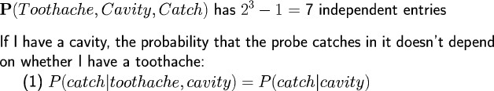
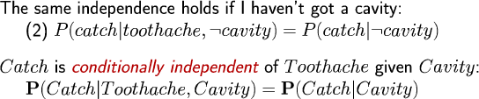
Conditional Independence
Instead of 7 entries, only need 5

Slide 20

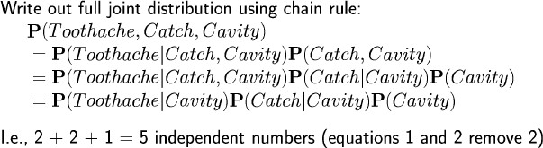
Conditional Independence II
P(catch | toothache, cavity) = P(catch | cavity) P(catch | toothache,¬cavity) = P(catch |¬cavity)
Why only 5 entries in table?

Slide 21
Power of Cond. Independence
Often, using conditional independence reduces the storage complexity of the joint distribution from exponential to linear!!
Conditional independence is the most basic & robust form of knowledge about uncertain environments.

Slide 22
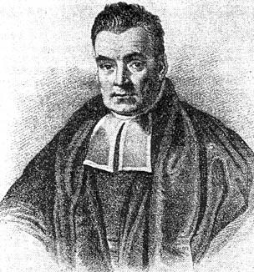

Bayes Rule
Bayes rules!
posterior
P(x, y) = P(x | y)P( y) = P( y | x)P(x)
_{P(x y) =} P( y | x) P(x) ₌ likelihood ⋅ prior
P( y) evidence

Slide 23

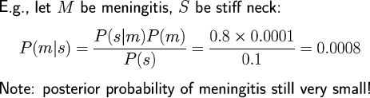
Computing Diagnostic Prob. from Causal Prob.
E.g. let M be meningitis, S be stiff neck
P(M) = 0.0001,
P(S) = 0.1,
P(S|M)= 0.8
P(M|S)

Slide 24
Other forms of Bayes Rule
_{P(x y) =} P( y | x) P(x) ₌ likelihood ⋅ prior
P( y)
P( y | x) P(x)
∑ P( y | x) P(x)
evidence
P(x y) =
x
P(x y) = αP( y | x)P(x) posterior ∝ likelihood ⋅ prior

Slide 25
Conditional Bayes Rule
_{P(x y, z) =} P( y | x, z) P(x | z)
P( y | z)
P( y | x, z) P(x, z)
∑ P( y | x, z) P(x | z)
P(x y, z) =
x
P(x y, z) = αP( y | x, z)P(x | z)

Slide 26
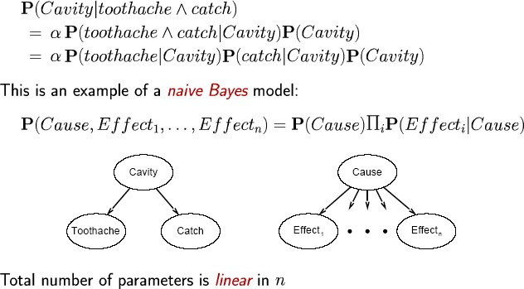
Bayes’ Rule & Cond. Independence

Slide 27
Simple Example of State Estimation
Suppose a robot obtains measurement z
What is P(doorOpen|z)?

Slide 28
Causal vs. Diagnostic Reasoning
P(open|z) is diagnostic.
P(z|open) is causal.
Often causal knowledg
e is easier to obtain.
count frequencies!
Bayes rule allows us to use causal knowledge:
_{P(open | z) =} P(z | open)P(open)
P(z)

Slide 29
Example
P(z|open) = 0.6
P(z|¬open) = 0.3
P(open) = P(¬open) = 0.5
P(z | open)P(open)
P(open | z) =
P(z | open) p(open) + P(z | ¬open) p(¬open)
0.6 ⋅ 0.5
P(open | z) =
= ² = 0.67
0.6 ⋅ 0.5 + 0.3⋅ 0.5 3
z raises the probability that the door is open.

Slide 30
Combining Evidence
Suppose our robot obtains another observation z₂.
How can we integrate this new information?
More generally, how can we estimate
P(x| z₁...z_{n} )?

Slide 31
Example: Second Measurement
P(z₂|open) = 0.5 P(z₂|¬open) = 0.6
P(open|z₁)=2/3
P(z₂ | open) P(open | z₁ )
P(open | z , z ) =
P(z₂ | open) P(open | z₁ ) + P(z₂ | ¬open) P(¬open | z₁ ) 1 ⋅ 2
2 1
= ² ³ = ⁵ = 0.625
1 ⋅ 2 ₊ 3 ⋅ 1
8
2 3 5 3
z₂ lowers the probability that the door is open.
•32

Slide 32
is there a general representation scheme for probabilistic inference?
These calculations seem laborious to do for each problem domain –
Yes – Bayesian Networks

